Slide 1


Mentor:
Presented by:
THAMIZHARASI P
MATHESHWARAN P M

Slide 2

AGENDA
Introduction
Problem Statement
Objective
Methodology
Technologies Used
System Workflow
Results
Advantages
Conclusion
Batch: 11 Page no: 02

Slide 3

INTRODUCTION
Fake news and misinformation spread rapidly on the
internet and social media.
It can mislead people and create confusion in society.
AI technology helps identify and filter fake news automatically.
Batch: 11 Page no: 03

Slide 4
PROBLEM STATEMENT
Large amount of news is shared online every day.
It is difficult for people to verify whether the news is real or fake.
A system is needed to automatically detect fake news using AI.
Batch: 11 Page no: 04

Slide 5
OBJECTIVE
Detect fake news using AI and Machine Learning
Analyze text patterns in news articles
Classify news as Real or Fake
Batch: 11 Page no: 05

Slide 6
METHODOLOGY
Collect news datasets
Preprocess text data
Convert text into numerical vectors
Train machine learning models
Predict whether news is real or fake
Batch: 11 Page no: 06

Slide 7
TECHNOLOGIES USED
Python
Streamlit
Machine Learning
Natural Language Processing (NLP)
Batch: 11 Page no: 07

Slide 8
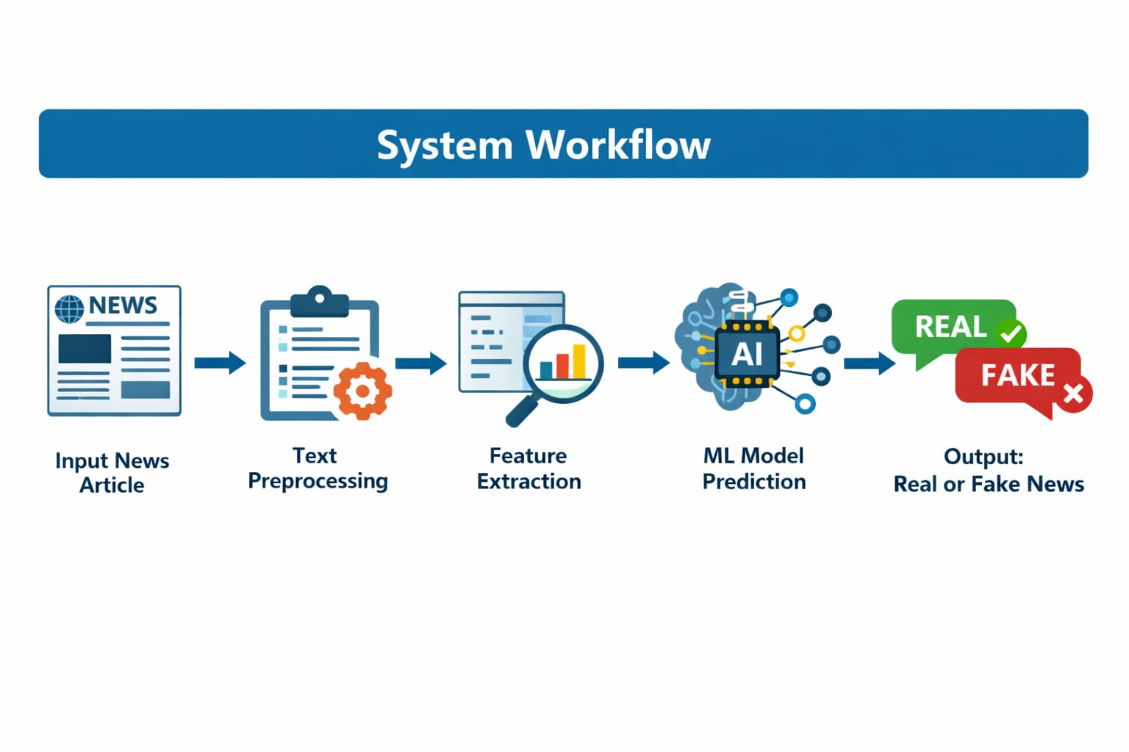
Batch: 11 Page no: 08

Slide 9
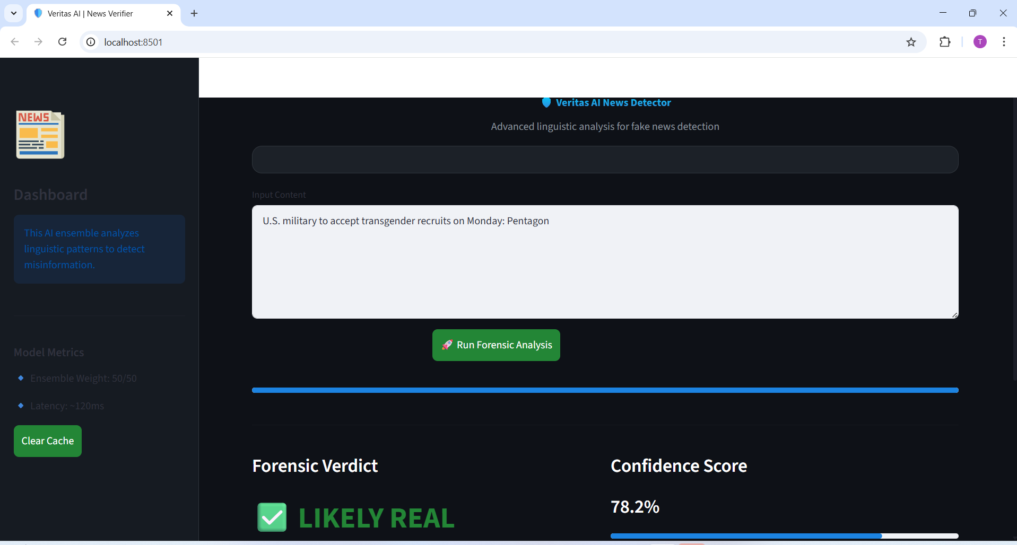
RESULTS - likely real
Batch: 11 Page no: 09

Slide 10
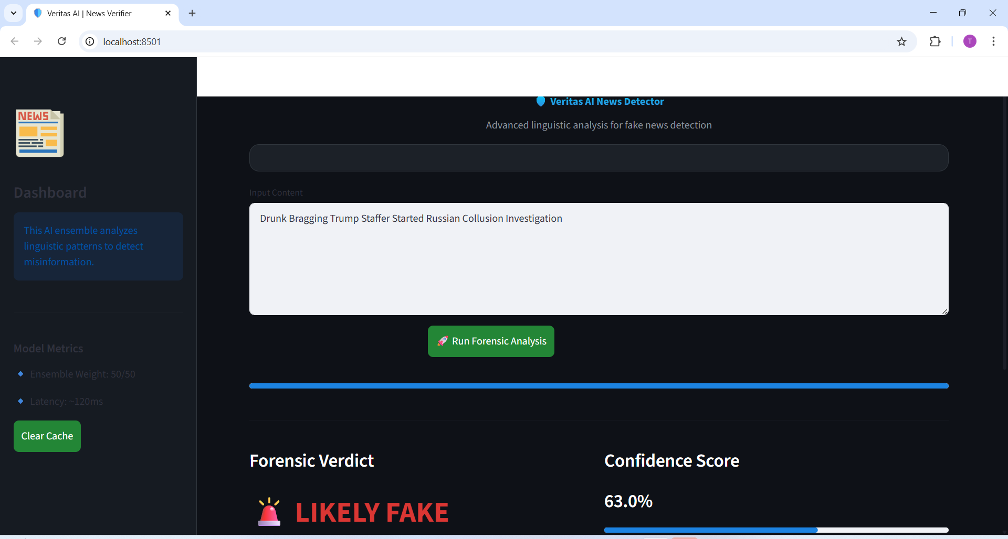
RESULTS - likely fake
Batch: 11 Page no: 10

Slide 11
ADVANTAGES
Helps reduce the spread of fake news.
Saves time in verifying information.
Improves awareness and trust in news sources.
Batch: 11 Page no: 11

Slide 12
CONCLUSION
AI-based fake news detection helps identify misinformation efficiently..
The system improves accuracy using machine learning models.
It can support journalists, researchers, and the public in verifying news.
Batch: 11 Page no: 12

Slide 13

Batch: 11 Page no: 13

